Slide 1
Cognition and Language
Seminar 4
Encoding distortions
The DRM paradigm

Slide 2
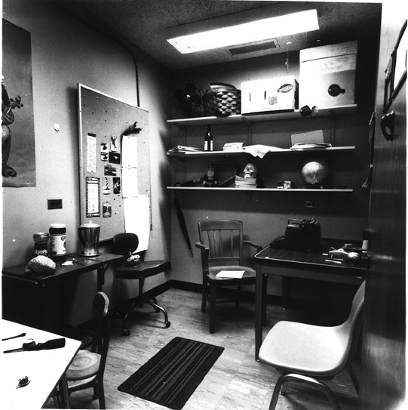

Slide 3
Reconstructing a scene
Write down all the objects you can remember.
Was there a chair?
Was there a table?
Was there a filing cabinet?
Was there a typewriter?
Were there books?
Was there a skull?
Was there a picnic basket?

Slide 4
Reconstructing a scene
Was there a chair? Yes
Was there a table? Yes
Was there a filing cabinet? No
Was there a typewriter? Yes
Were there books? No
Was there a skull? Yes
Was there a picnic basket? Yes

Slide 6
Encoding Distortions
Selection
You only encode information that fits with your prior knowledge
Notes:
<number>

Slide 7
Another memory test
A series of words will be presented on the following slides at a rate of 1 word/sec.
Memorize each word as it appears on the slide

Slide 8
Door

Slide 9
Glass

Slide 10
Pane

Slide 11
Shade

Slide 12
Ledge

Slide 13
Sill

Slide 14
House

Slide 15
Open

Slide 16
Curtain

Slide 17
Frame

Slide 18
View

Slide 19
Breeze

Slide 20
Sash

Slide 21
Screen

Slide 22
Shutter

Slide 23
Instructions
Write down as many words as you can remember!

Slide 24
Did you see…?
A = Yes, B = No
Door
Glass
Pane
Shade
Window

Slide 25
Window was not on the list!
Door Sill View
Glass House Breeze
Pane Open Sash
Shade Curtain Screen
Ledge Frame Shutter
You just integrated the list items to form a new representation – a false memory.
This is called the Deese-Roediger-McDermott (DRM) paradigm.

